Slide 1
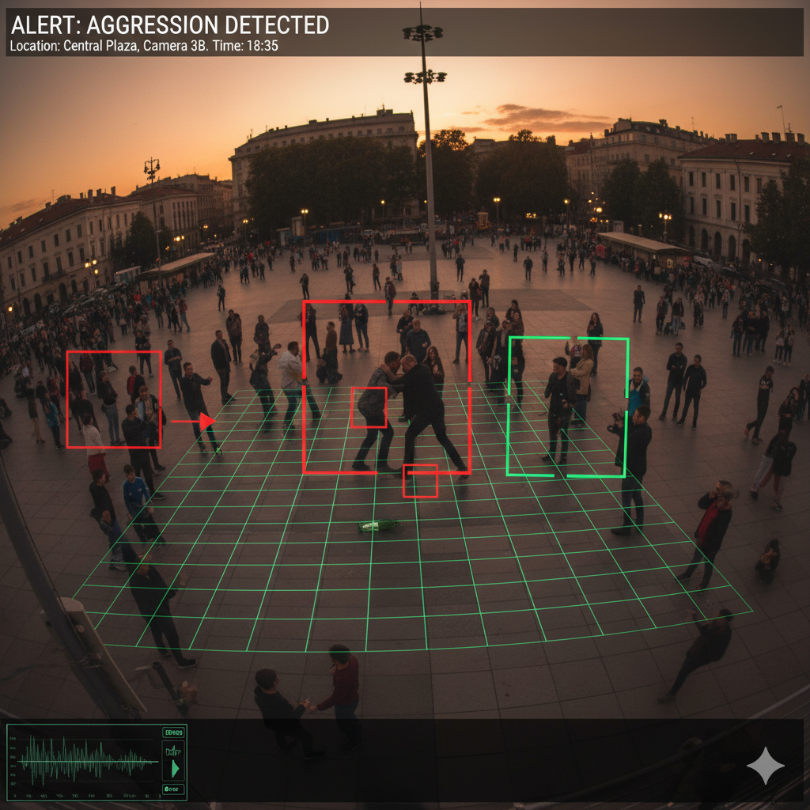
Real-Time Violence Detection Using CNN-LSTM Models
Notes:
1

Slide 2
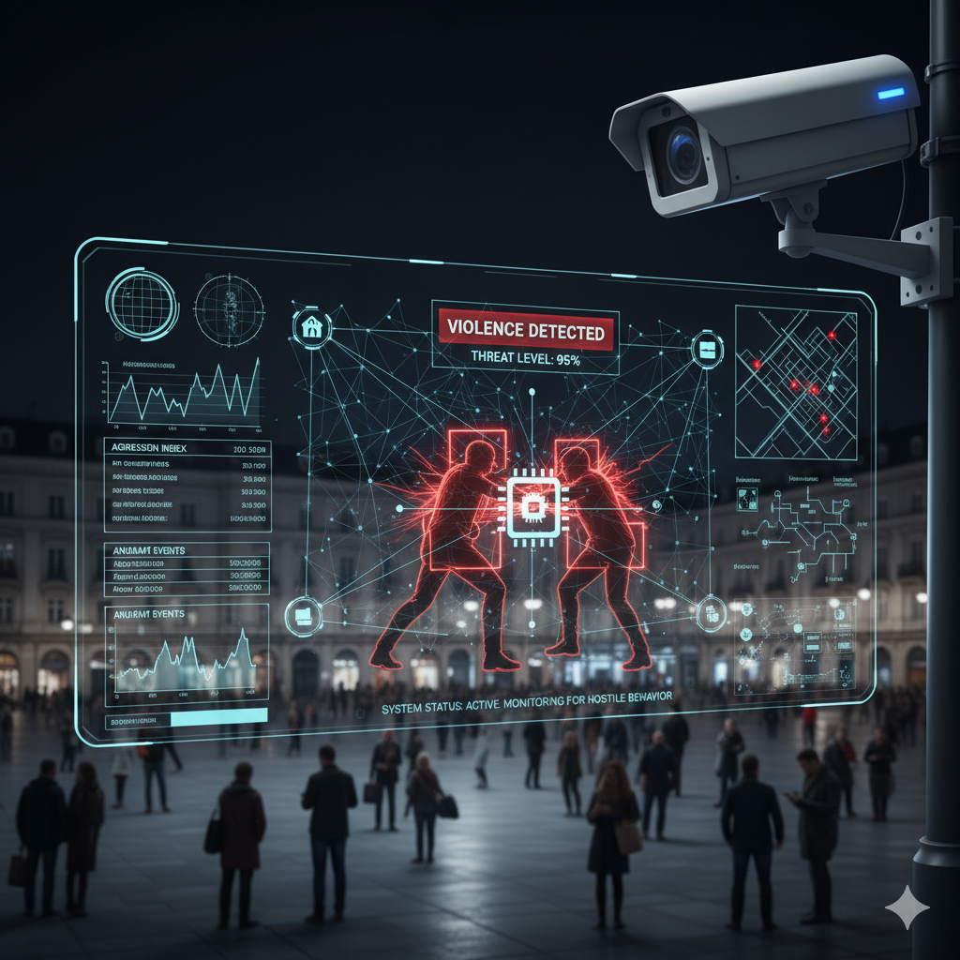
The Need for Proactive Security
Traditional CCTV monitoring is fundamentally reactive, not preventative. Current surveillance systems analyze incidents after they occur, creating critical security gaps.
Delayed Response
Analysis happens after incidents occur, limiting intervention opportunities and emergency response effectiveness.
Human Error & Fatigue
Manual monitoring is unreliable, prone to error, and not scalable for large camera networks.
Project Vision: Engineer an automated system that detects violence in real-time, enabling immediate intervention and transforming surveillance from passive to active security.
Notes:
2

Slide 3

Literature Review: Foundational Models & Their Limitations
Two-Stream CNNs (Simonyan & Zisserman, 2014)
Specification: Separates video into spatial stream (appearance) and temporal stream (motion using optical flow).
Limitation: Pre-calculation of optical flow is computationally expensive, creating bottlenecks for real-time analysis.
3D Convolutional Networks (C3D) (Tran et al., 2015)
Specification: Uses 3D kernels to learn spatial and temporal features simultaneously from video clips.
Limitation: High computational demand and requires massive datasets, making deployment on standard hardware challenging.
Notes:
4

Slide 4



Justifying Our Framework Selection
Inflated 3D ConvNets (I3D)
Specification: Achieves state-of-the-art accuracy by "inflating" deep 2D image models into 3D, pre-trained on Kinetics dataset.
Limitation: Extremely high computational cost, unsuitable for real-time deployment goals.
Our Selection: Hybrid CNN-LSTM
Justification: Optimal balance of performance and computational efficiency. Decouples tasks using lightweight CNN for spatial features and LSTM for temporal analysis.
Notes:
5

Slide 5
System Architecture: Modular Design
01
02
03
Video Input & Preprocessing
Spatial Feature Extraction (CNN)
Temporal Pattern Analysis (LSTM)
Ingests video streams, decomposes into frames, resizes to 224x224, and normalizes pixel values for consistent input.
Pre-trained MobileNetV2 extracts semantic features from each frame, leveraging transfer learning for efficiency.
LSTM network analyzes sequential features over time to identify violent behavior patterns and temporal dependencies.
04
05
Violence Classification
Automated Response
Final dense layer classifies sequences as "Violent" or "Non-Violent" based on extracted spatiotemporal features.
Triggers real-time alerts via Telegram notifications and logs incidents to MySQL database for analysis.
Notes:
6

Slide 6




Framework & Component Justification
Development Framework
Spatial Component
Python with TensorFlow/Keras: Robust, well-supported, and production-ready ecosystem for deep learning applications with extensive community support.
MobileNetV2: Lightweight architecture crucial for real-time processing. Transfer learning from ImageNet pre-training enhances performance efficiency.
Temporal Component
LSTM Networks: Proven ability to learn long-term dependencies in sequential data, essential for distinguishing violent actions from normal movements.
Notes:
7

Slide 7






Curating a Robust and Diverse Dataset
Challenge: Model accuracy depends heavily on data quality and diversity. Single datasets often contain environmental biases and staged events.
UCF-Crime
Massive dataset of untrimmed surveillance videos containing 13 realistic anomaly categories, including "Fighting" and "Assault".
RWF-2000
Large-scale dataset with 2,000 real-world fighting clips from surveillance cameras, providing authentic violence scenarios.
Composite Strategy
Combined datasets create a more generalizable model, reducing bias and improving real-world performance across diverse environments.
Notes:
8

Slide 8
Project Timeline & Adherence
Phase 1: Research & Planning (Weeks 1-2)
1
Status: CompletedLiterature review and comprehensive system design documentation.
2
Phase 2: Environment Setup (Weeks 3-4)
Status: CompletedSoftware installation and library configuration for development environment.
Phase 3: Data Collection & Cleaning (Weeks 5-6)
3
Status: CompletedCurating and preprocessing composite dataset from RWF-2000 and UCF-Crime sources.
4
Phase 4: Model Development & Training (Weeks 7-10)
Status: In ProgressImplementing and training the CNN-LSTM hybrid model architecture.
Phase 5: Integration & Testing (Weeks 11-12)
5
Status: UpcomingIntegrating alerting system and conducting comprehensive final evaluation.
Notes:
9

Slide 9


Demonstration of Completed Work
Data Collection and Cleaning
Status: Completed
Videos from RWF-2000 and UCF-Crime datasets successfully gathered
Data cleaned by selecting relevant categories and ensuring consistent formatting
Dataset prepared and optimized for training phase requirements
Video Preprocessing Pipeline
Status: Completed
Operational script automatically ingests videos and extracts frames
Frames resized to 224x224 with normalized pixel values
Pipeline successfully applied to entire cleaned dataset
Notes:
10

Slide 10
Thank You - Questions?
Notes:
11

